Slide 1
Theme Park Adventure - A Text Adventure Game!
Software Development Team:
Elijah Morishita
Gabriel Woodburn
Robert Knar
Jason Shi

Slide 2
Ever wish you could enjoy the theme park without actually having to go to the theme park?
Well we have the perfect simulation for you, custom fit to your personality type we’ll have the perfect adventure for you to enjoy ☺
… let’s take a look around…

Slide 3
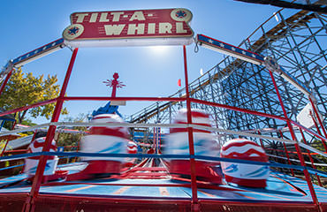
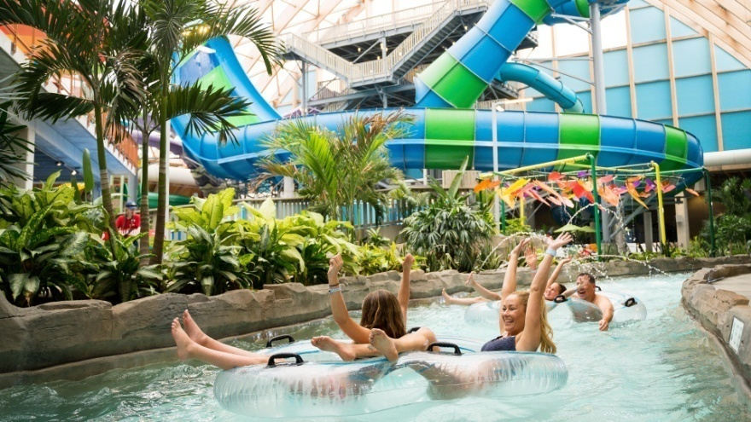
Our theme Park consists of the following sections…
The Kiddie Park
The Water Park

Slide 4
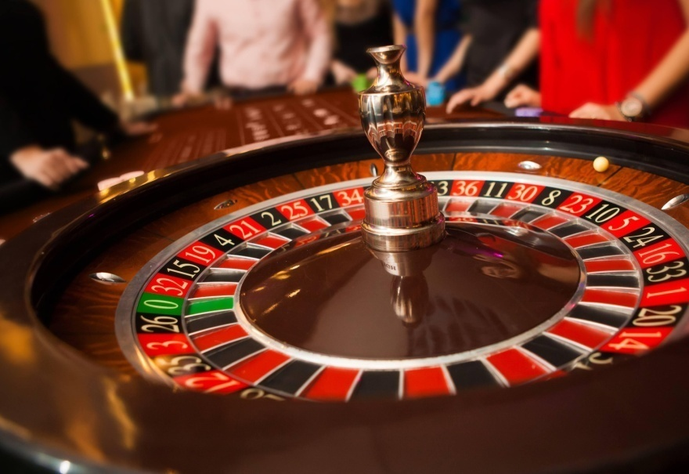
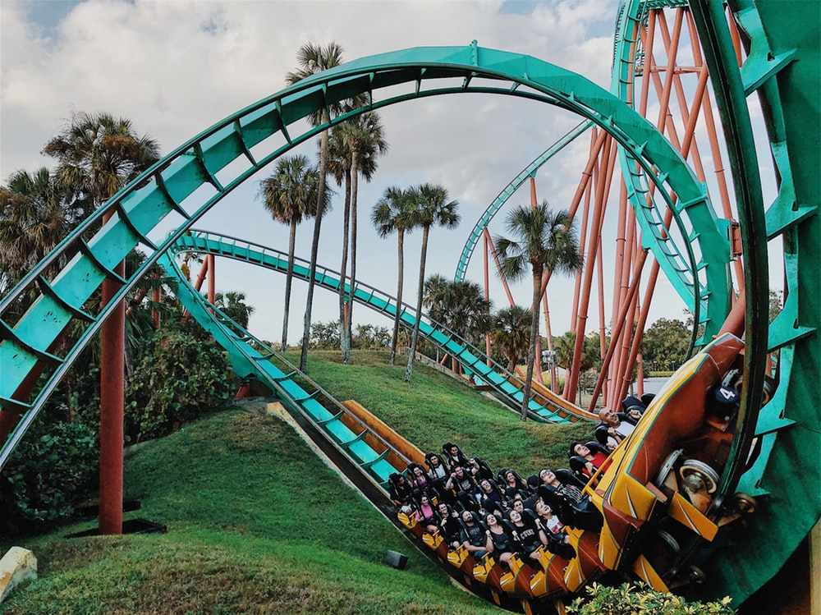
Our theme Park consists of the following sections…
The Casino
The Thrill Park

Slide 5
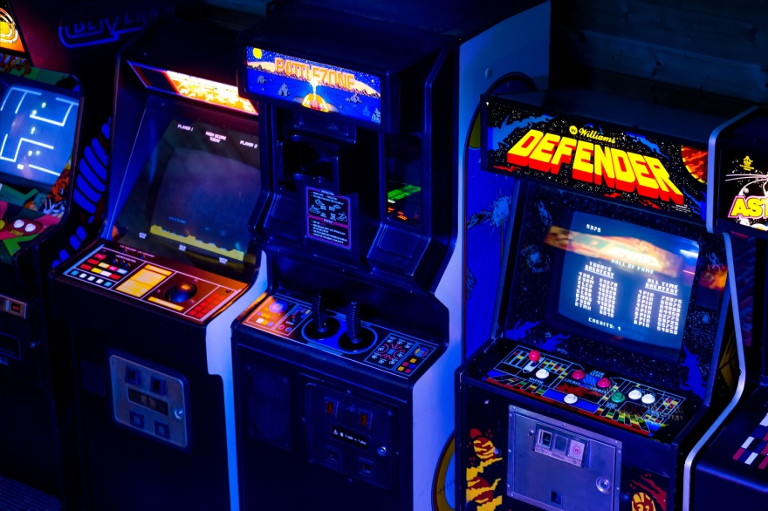
Our theme Park consists of the following sections…
The Arcade

Slide 6
Very Exciting Right! ☺
Once you get started just keep in mind the following rules…
DON’T run out of money.
That just wouldn’t be cool, we want you to have fun and spend your money wisely, rather than have to kick you out of the park for being broke – no fun for either of us ☹
DON’T die.
Again, your current state of ongoing existence is much more preferable than the alternative.

Slide 7
In conclusion
We hope you have fun and invite all your friends to play THEME PARK ADVENTURE! ☺

